Slide 1
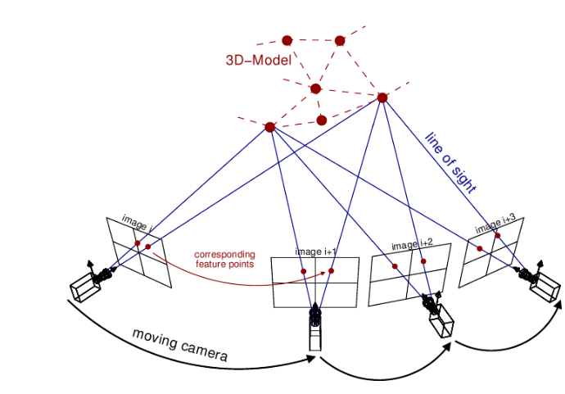

Slide 2
SLAM with Objects using a Nonparametric Pose Graph
Beipeng Mu, Shih-Yuan Liu, Liam Paull, John Leonard, onathan P. How
IROS 2016
Probabilistic Data Association for Semantic SLAM
Sean L. Bowman, Nikolay Atanasov, Kostas Daniilidis, George J. Papas
ICRA 2017
Sher and Alon

Slide 3
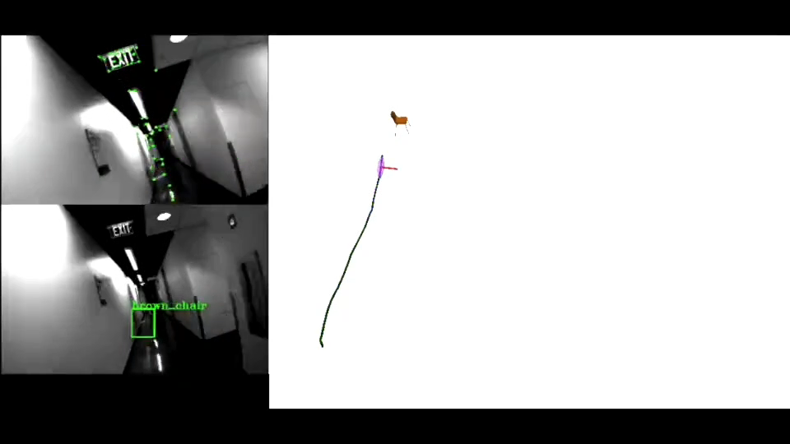
What is semantic slam
Probabilistic Data Association for Semantic SLAM
ICRA 2017

Slide 4
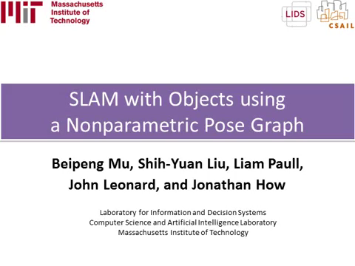
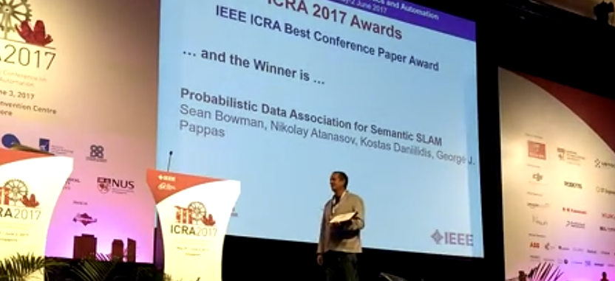

Slide 5
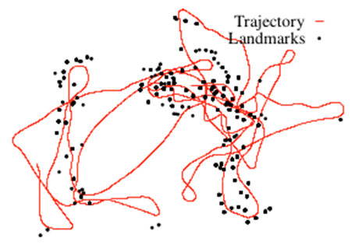
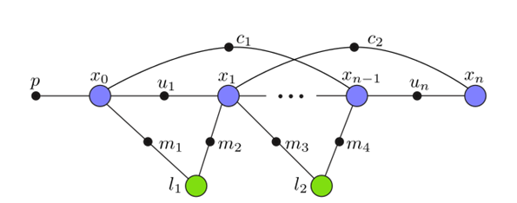
2011
When did the community start working on Semantic Slam
Graph Optimization Toolboxes
2011: g2o
2012: ISAM2

Slide 6
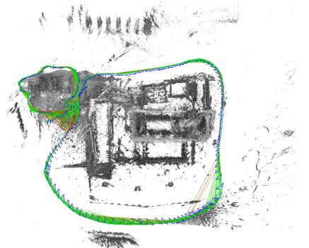
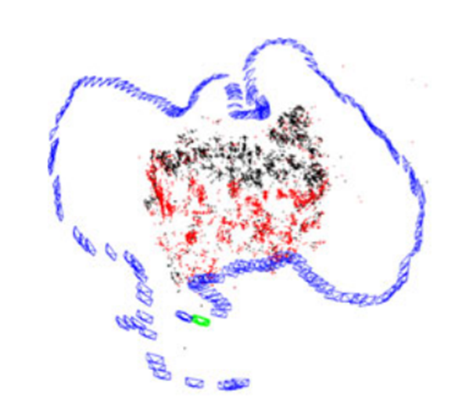
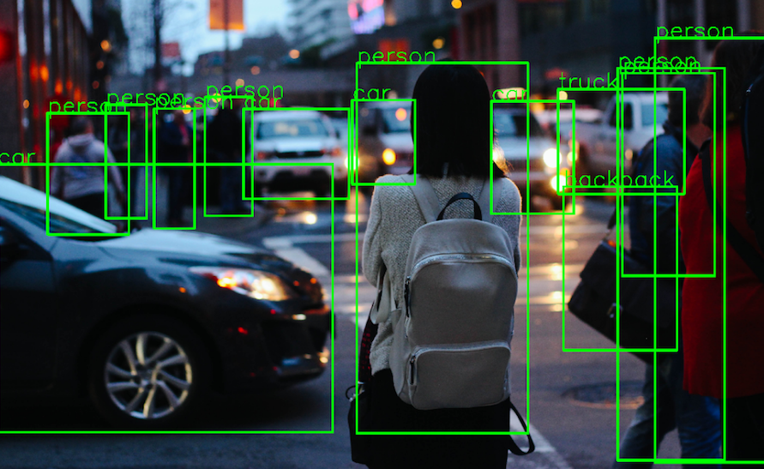
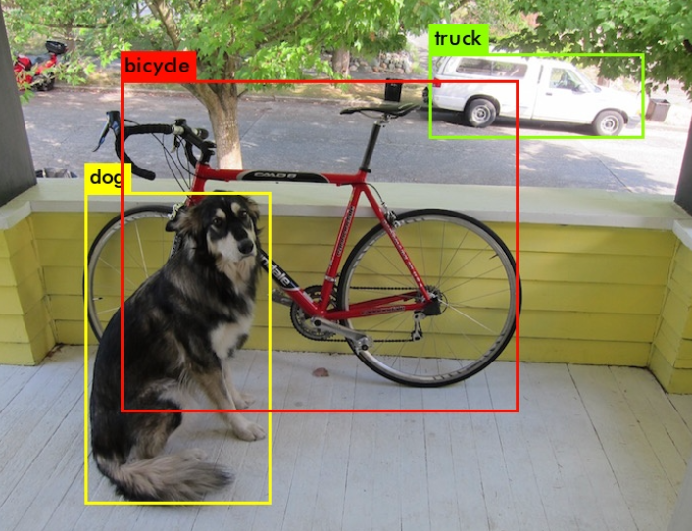
2011
When did the community start working on Semantic Slam
Graph Optimization Toolboxes
2014
Geometrical SLAMS with graph optimization
+
Object Detection using deep neural networks
2014: LSD-SLAM
2015: ORB-SLAM
2014: R-CNN
2015: You Only Look Once (YOLO)

Slide 7
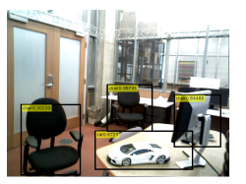
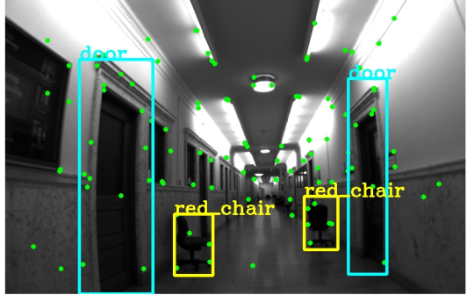
2011
When did the community start working on Semantic Slam
Graph Optimization Toolboxes
2014
Geometrical SLAMS with graph optimization
+
Object Detection using deep neural networks
2016: SLAM with Objects using a Nonparamteric Pose Graph
2016
Semantic Slams
With graph optimization
2017: Probabilistic Data Association for Semantic SLAM

Slide 8

What are the advantages of Semantic Slam
$$→better mapping$$
$$→better localization$$

Slide 9
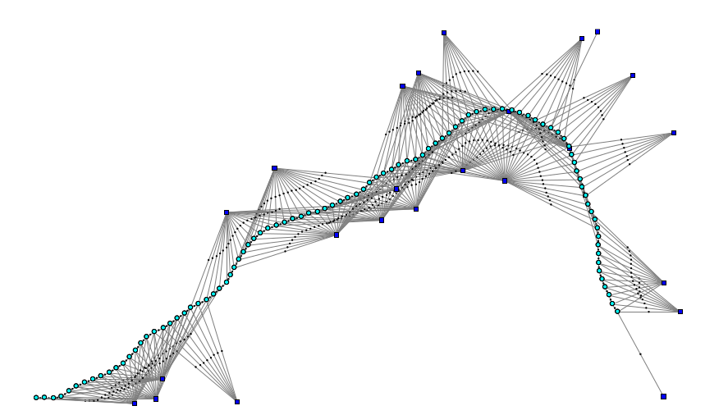

What are the advantages and challenges of semantic SLAM
Geometrical Pose Slam Optimization Problem
Landmarks
Measurement
Poses
Odometry

Slide 10
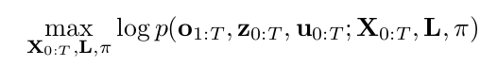
What are the advantages and challenges of semantic SLAM
Semantic Pose Slam Optimization Problem
Landmark Classes
Landmarks Positions
Geometrical Measurement
Pose
Class measurement
Odometry

Slide 11
Geometrical
State With Measurements
Semantic
Slam optimization - backend

Slide 12
Main Contribution
Point 1
point2

Slide 13
METHOD

Slide 14
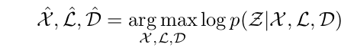
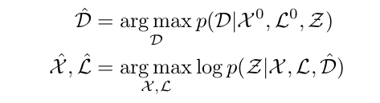

Slide 15
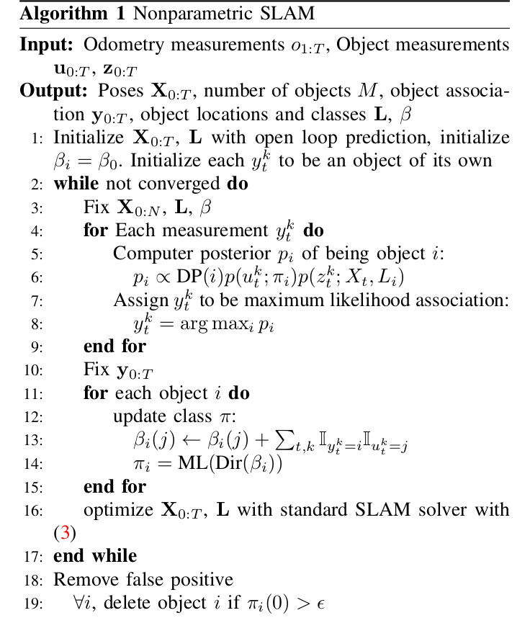

Slide 16
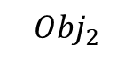
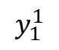
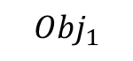
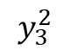
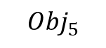
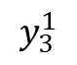
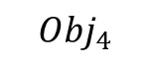
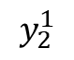
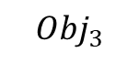
Ground Truth
$${Obj}_{4}$$
$$y_{3}^{2}$$
$${Obj}_{3}$$
8 objects
M objects
$$y_{3}^{1}$$
$${Obj}_{2}$$
$$y_{2}^{1}$$
$$y_{1}^{1}$$
$${Obj}_{1}$$
$${Obj}_{5}$$

Slide 17
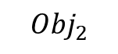
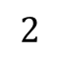
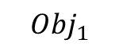
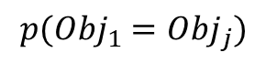
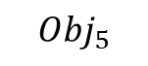

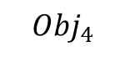
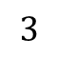
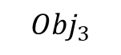
$${Obj}_{4}$$
$${Obj}_{3}$$
$${Obj}_{2}$$
$${Obj}_{1}$$
$${Obj}_{5}$$
$$p\left(u_{t}^{k} | π_{i}\right)p\left(z_{t}^{k} | X_{t},L_{i}\right)=f\left(class\right)∗f(space)$$
$$p({Obj}_{1}={Obj}_{j})$$
$$2$$
$$3$$
$$4$$

Slide 18
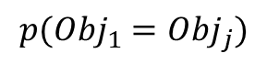
$${Obj}_{4}$$
$${Obj}_{3}$$
$${Obj}_{2}$$
$${Obj}_{1}$$
$${Obj}_{5}$$
$$p\left(u_{t}^{k} | π_{i}\right)p\left(z_{t}^{k} | X_{t},L_{i}\right)=f\left(class\right)∗f(space)$$
$$p({Obj}_{1}={Obj}_{j})$$
$$2$$
$$3$$
$$4$$

Slide 20
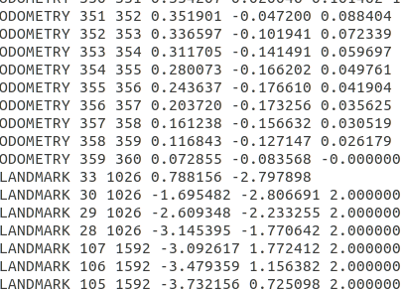

Slide 22
Simulation

Slide 23
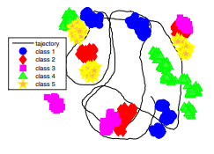
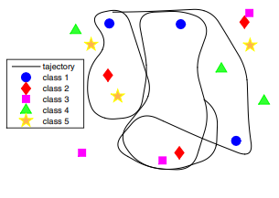

$$Graund Truth$$
$$\text{NP}\text{ - }\text{Graph} \text{after} 0 \text{ite}\text{ration}$$
$$1098 objects detected$$
$$just FBF$$
Notes:
Result of nonparametric pose graph at different iterations. Initially there are 1098 object detections. The number reduces to 33 after the first iteration, reduces to 20 after the second iteration, and converges to the ground truth 15 after 3 iterations.

Slide 24
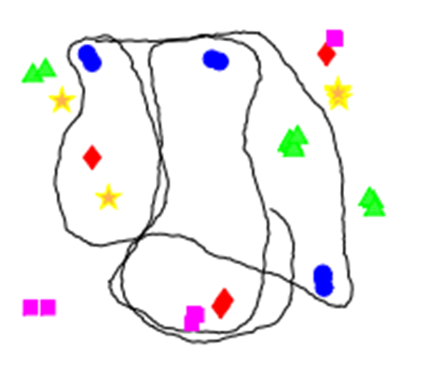

$$Graund Truth$$
$$\text{NP}\text{ − }\text{Graph} \text{after} 1 \text{iteration}$$
$$33 objects detected$$
Notes:
Result of nonparametric pose graph at different iterations. Initially there are 1098 object detections. The number reduces to 33 after the first iteration, reduces to 20 after the second iteration, and converges to the ground truth 15 after 3 iterations.

Slide 25
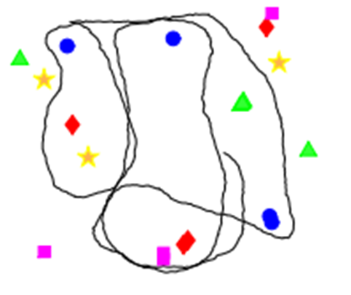

$$Graund Truth$$
$$\text{NP}\text{ − }\text{Graph} \text{after} 2 \text{iteration}$$
$$20 objects detected$$
Notes:
Result of nonparametric pose graph at different iterations. Initially there are 1098 object detections. The number reduces to 33 after the first iteration, reduces to 20 after the second iteration, and converges to the ground truth 15 after 3 iterations.

Slide 26
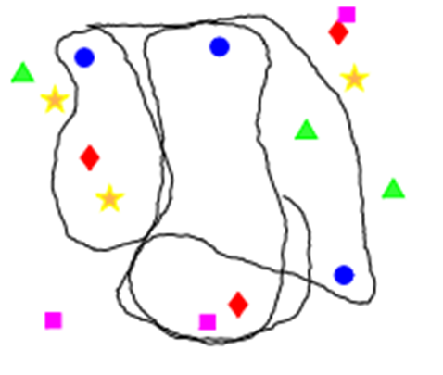

$$Graund Truth$$
$$\text{NP}\text{ − }\text{Graph} \text{after} 3 \text{iteration}$$
$$15 objects detected$$
Notes:
Result of nonparametric pose graph at different iterations. Initially there are 1098 object detections. The number reduces to 33 after the first iteration, reduces to 20 after the second iteration, and converges to the ground truth 15 after 3 iterations.

Slide 27
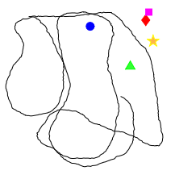
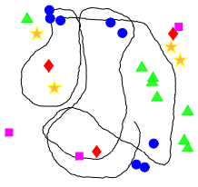
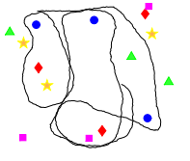
$$Graund Truth$$
$$R −SLAM$$
$$Open Loop$$
$$NP −Graph after 3 iterations$$
Notes:
OL associate object detection across images but does not optimize robot poses. R-SLAM only uses a subset of consistent object measurements to optimize robot poses. Our approach NP-graph optimizes both robot poses and data association.

Slide 28
Experiment

Slide 29
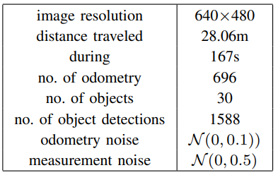
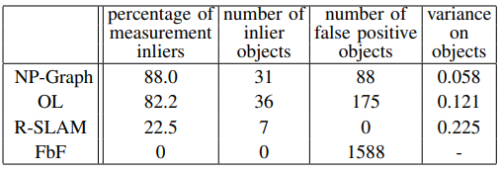
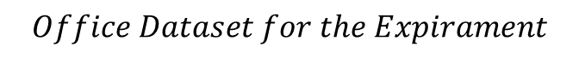
$$Office Dataset for the Expirament$$
$$Performance Comparison on Office Dataset$$

Slide 30
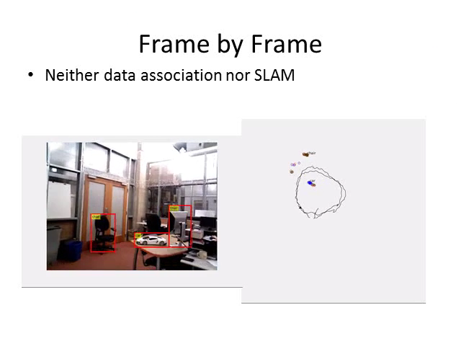
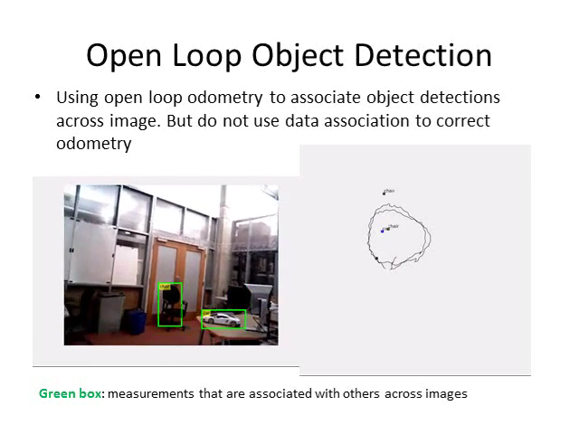
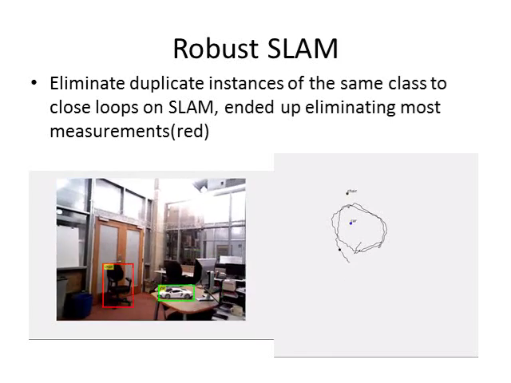


Slide 31
Conclusions
Notes:
Object SLAM is challenging as data association is ambiguous and location measurements unknown. Data association and SLAM are inherently coupled problems. This work proposed a novel nonparametric pose graph that tightly couples these two problems, and developed an algorithm to alternative between inferring data association and performing SLAM. Both simulated and real-world datasets show that our new approach has the capability of doing data association and SLAM simultaneously, and achieves better performance on both associating object detections to unique identifiers and localizing objects.

